Slide 1

Work in Progress
Padma C.R.
26th July 2017

Slide 2
CONTENTS
Transmit chain @ 405kHz
HFSS simulation of head coil for 9.5 mT
HFSS simulation of Birdcage head coil for 1.5T
TR switch for simulation for 1.5T
@ MIRC from May 2017 to July 2017

Slide 3
Transmit chain @ 405kHz
Signal Generator
Transmit coil
RF amplifier
T/R Switch
Signal Generator
Receive
chain
RF amplifier
T/R Switch
Transmit coil
Receive
coil

Slide 4
Transmit chain @ 405kHz
Arduino Duo
Transceiver coil
RF amplifier
T/R Switch
Signal Generator
Receive
chain
RF amplifier
T/R Switch
Transmit coil
Receive
coil

Slide 5
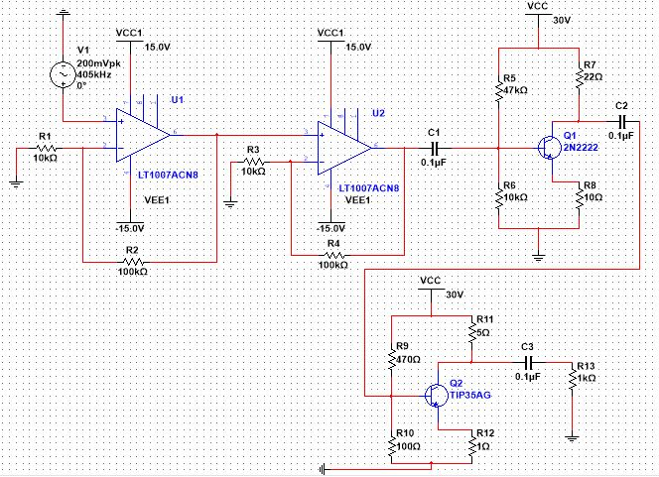
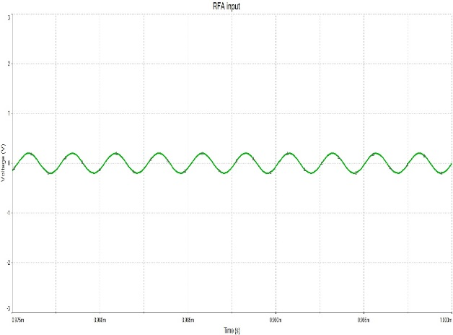
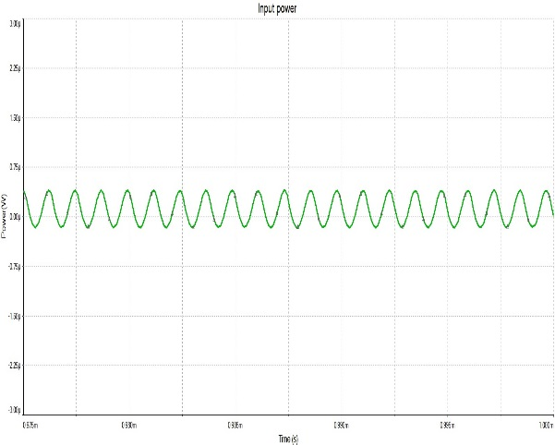
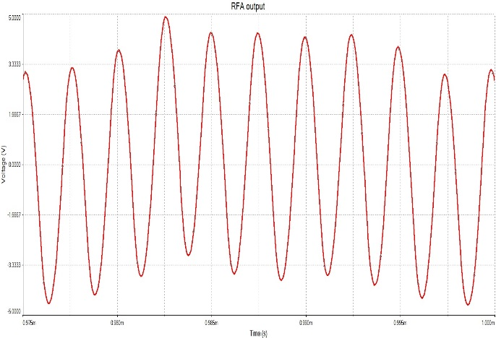
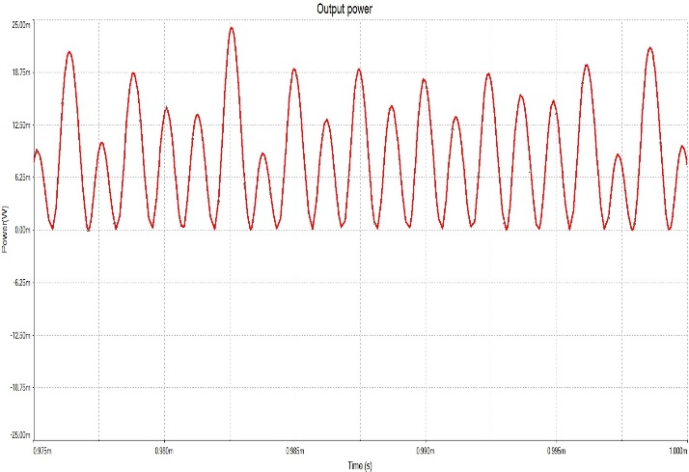
RF power amplifier
Input : 200mV
Output 10V
Input power of 550nW
Output power: 22.5mW

Slide 6
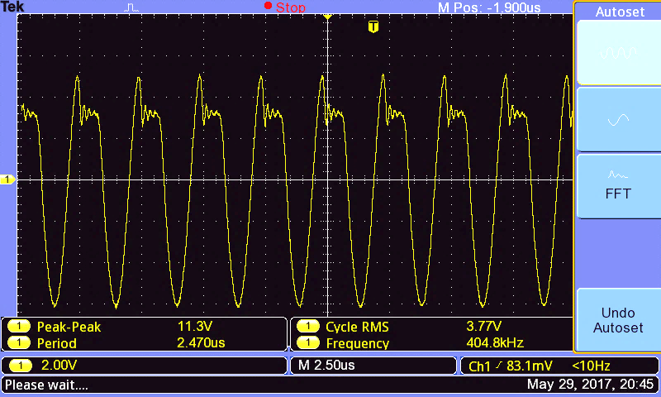
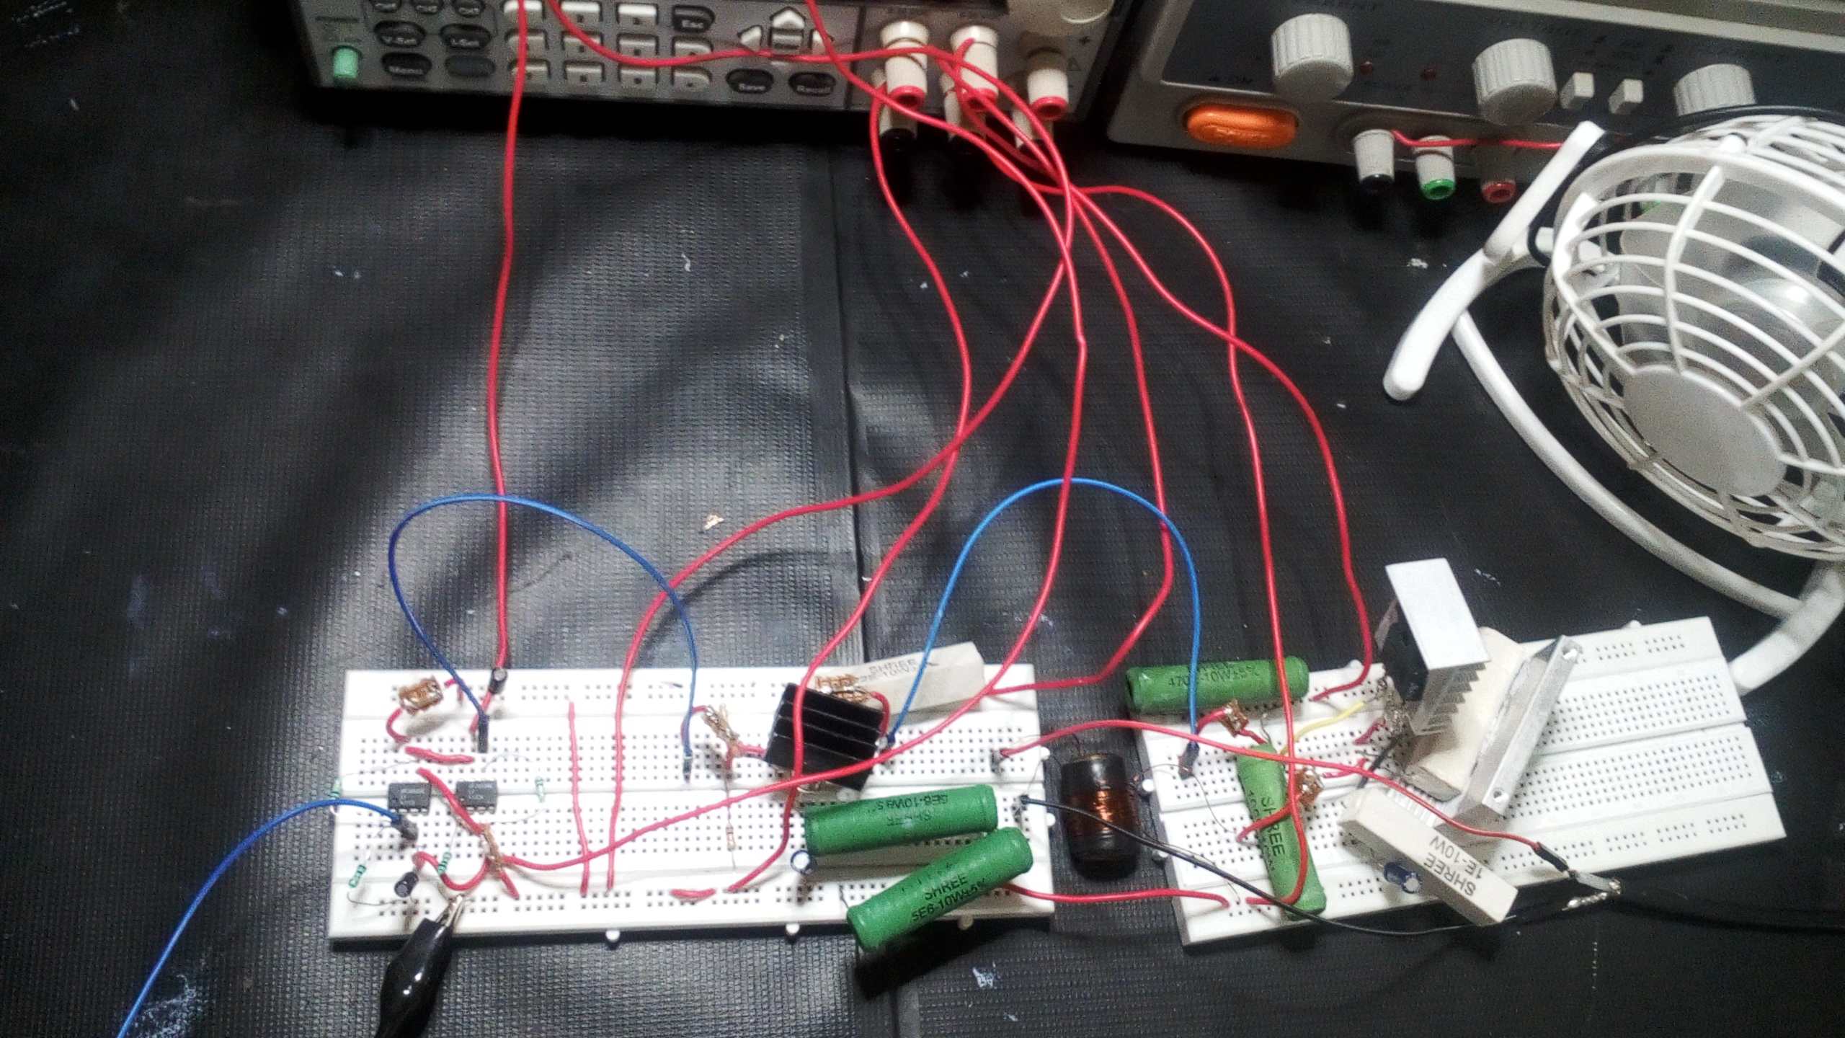
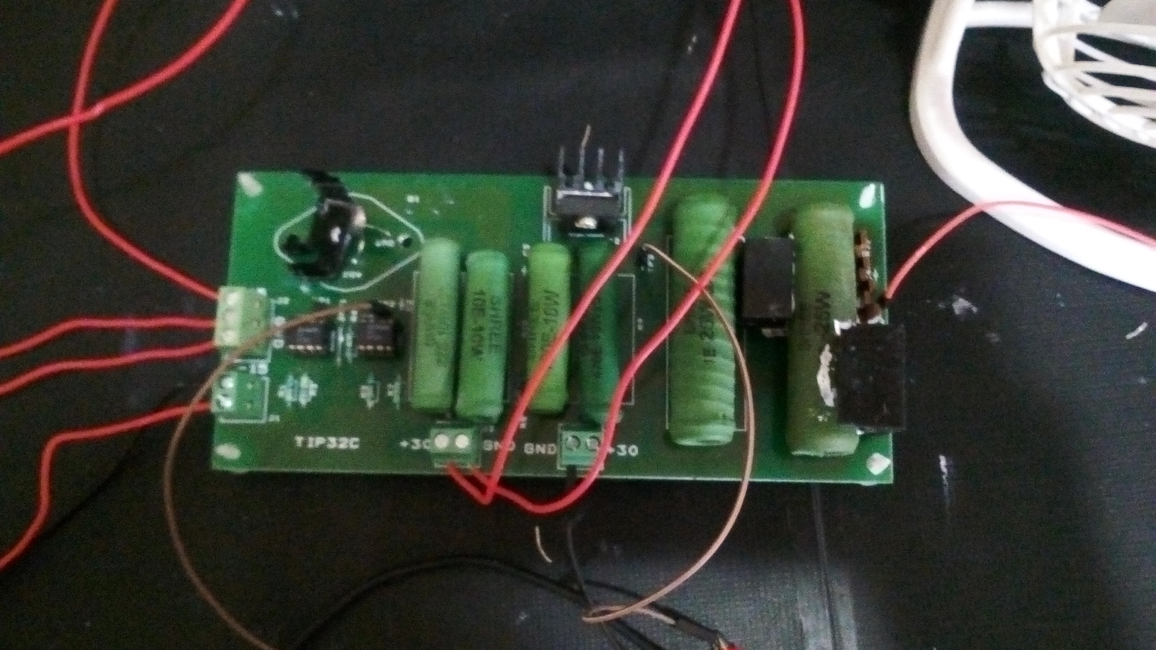
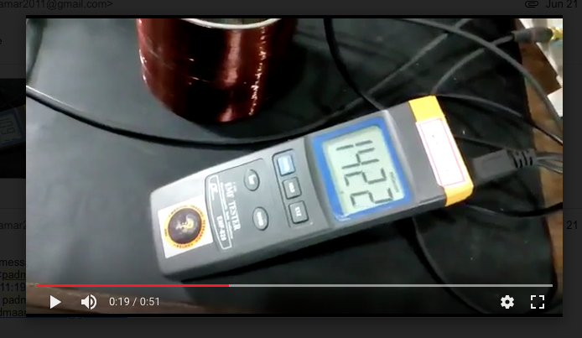
RF power amplifier – Bench test
Class A Amplifier

Slide 7
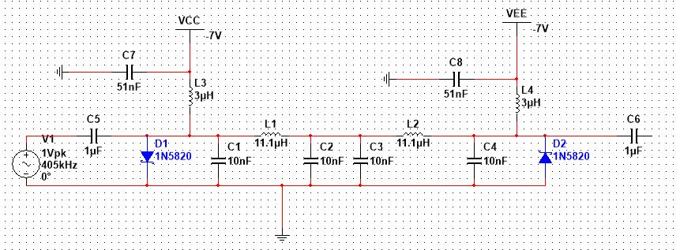
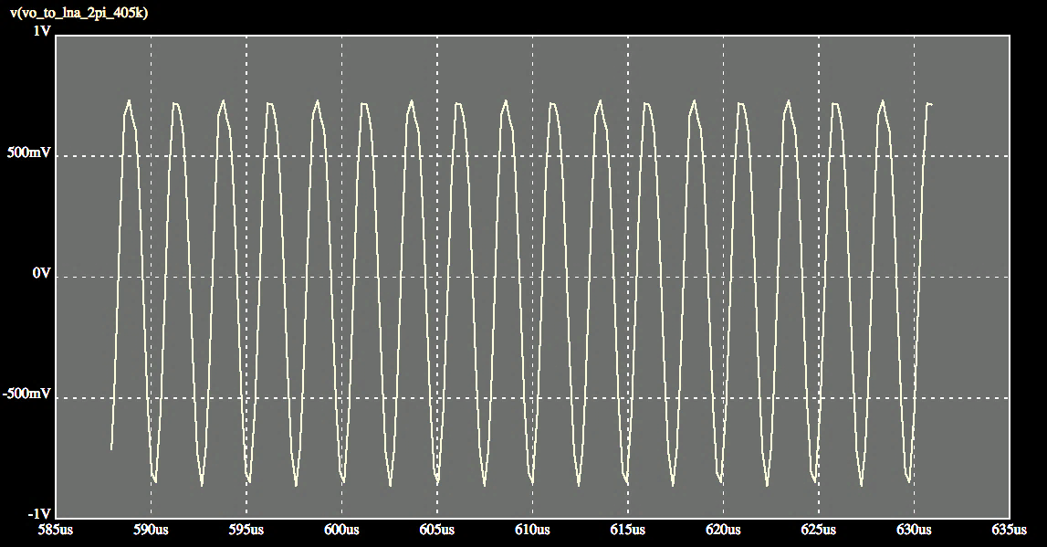
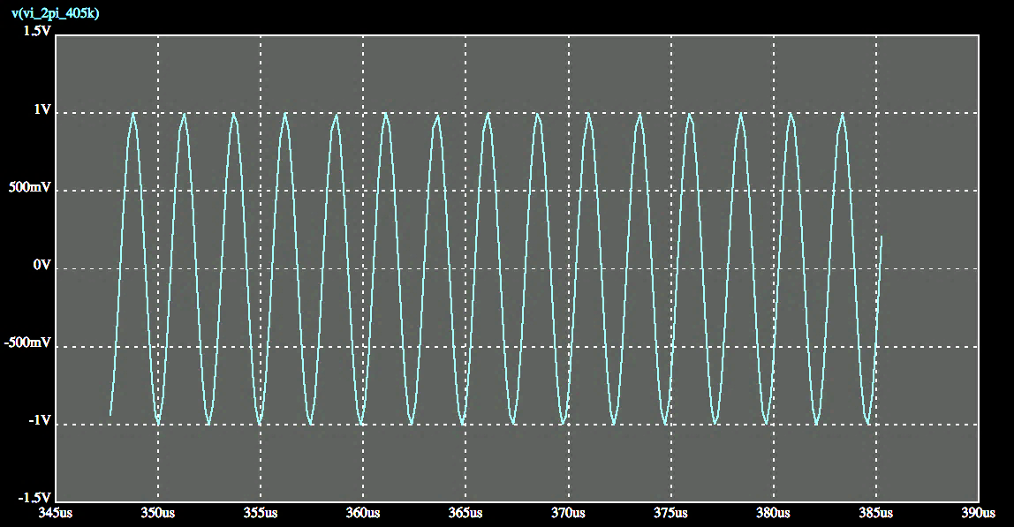
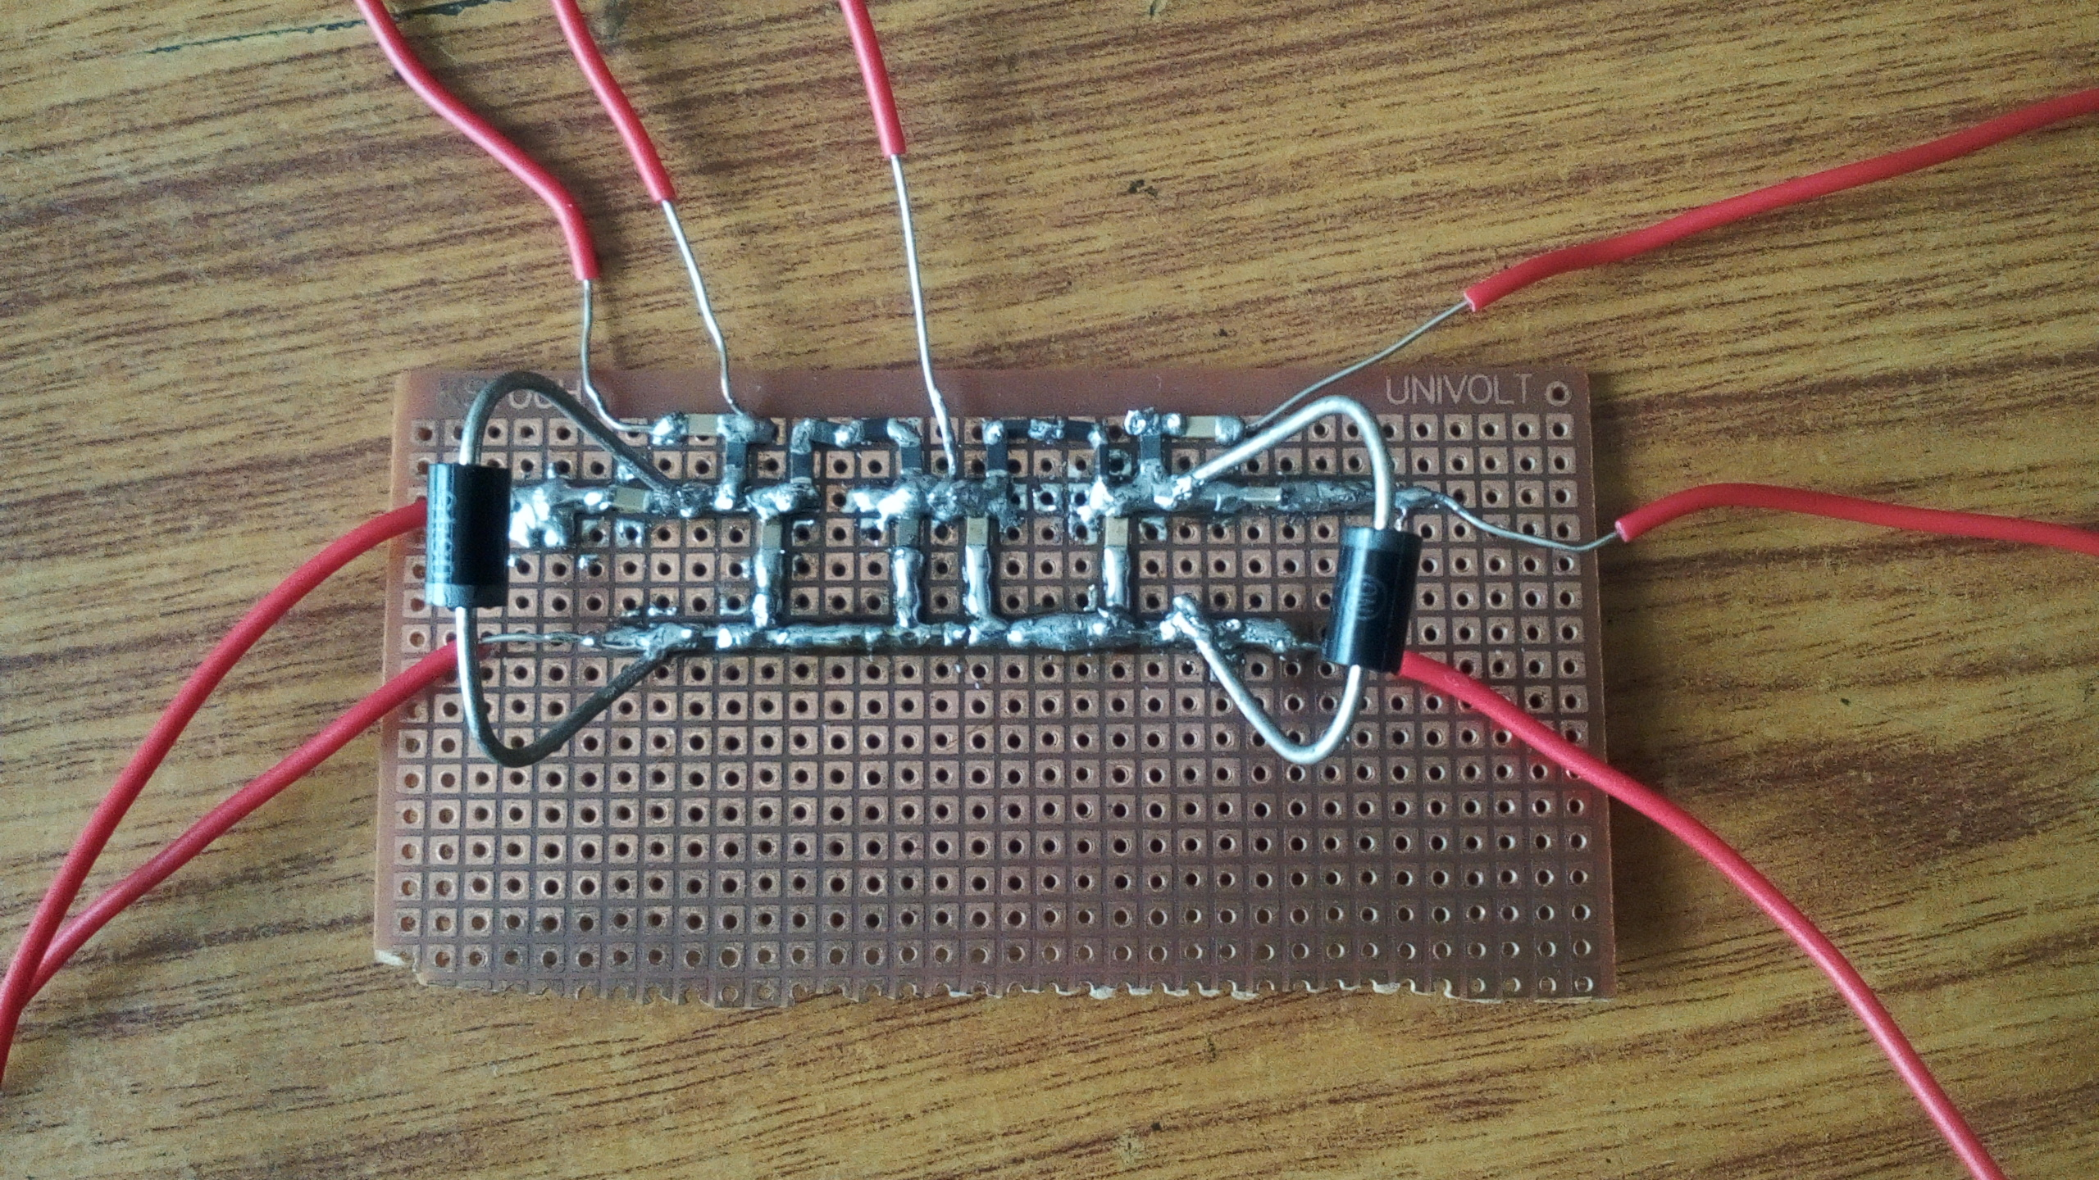
TR Switch simulation
L = 50/w
C = 1/ 50w
(ref. : Andrew Webb)

Slide 8
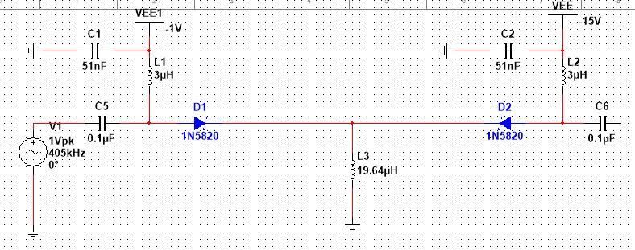
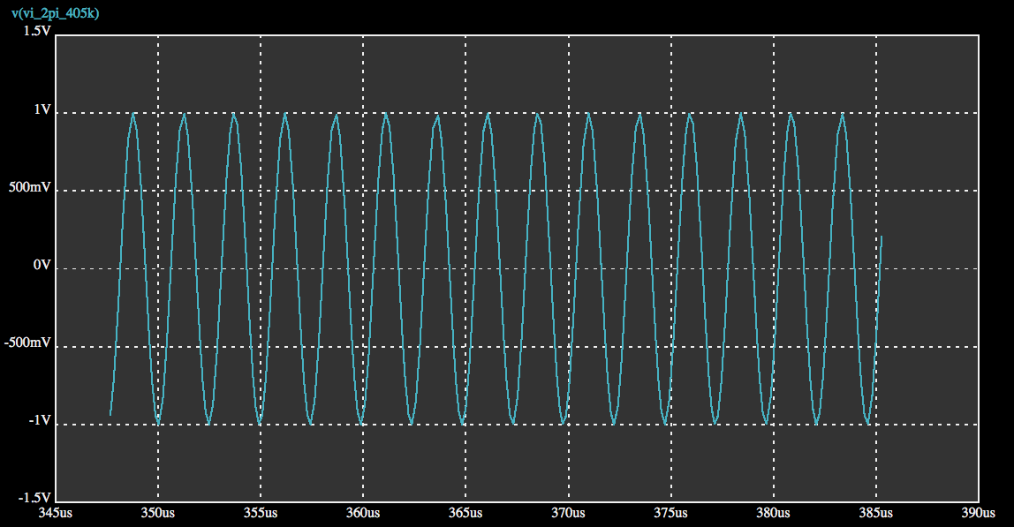
TR Switch simulation (2 port network)

Slide 9
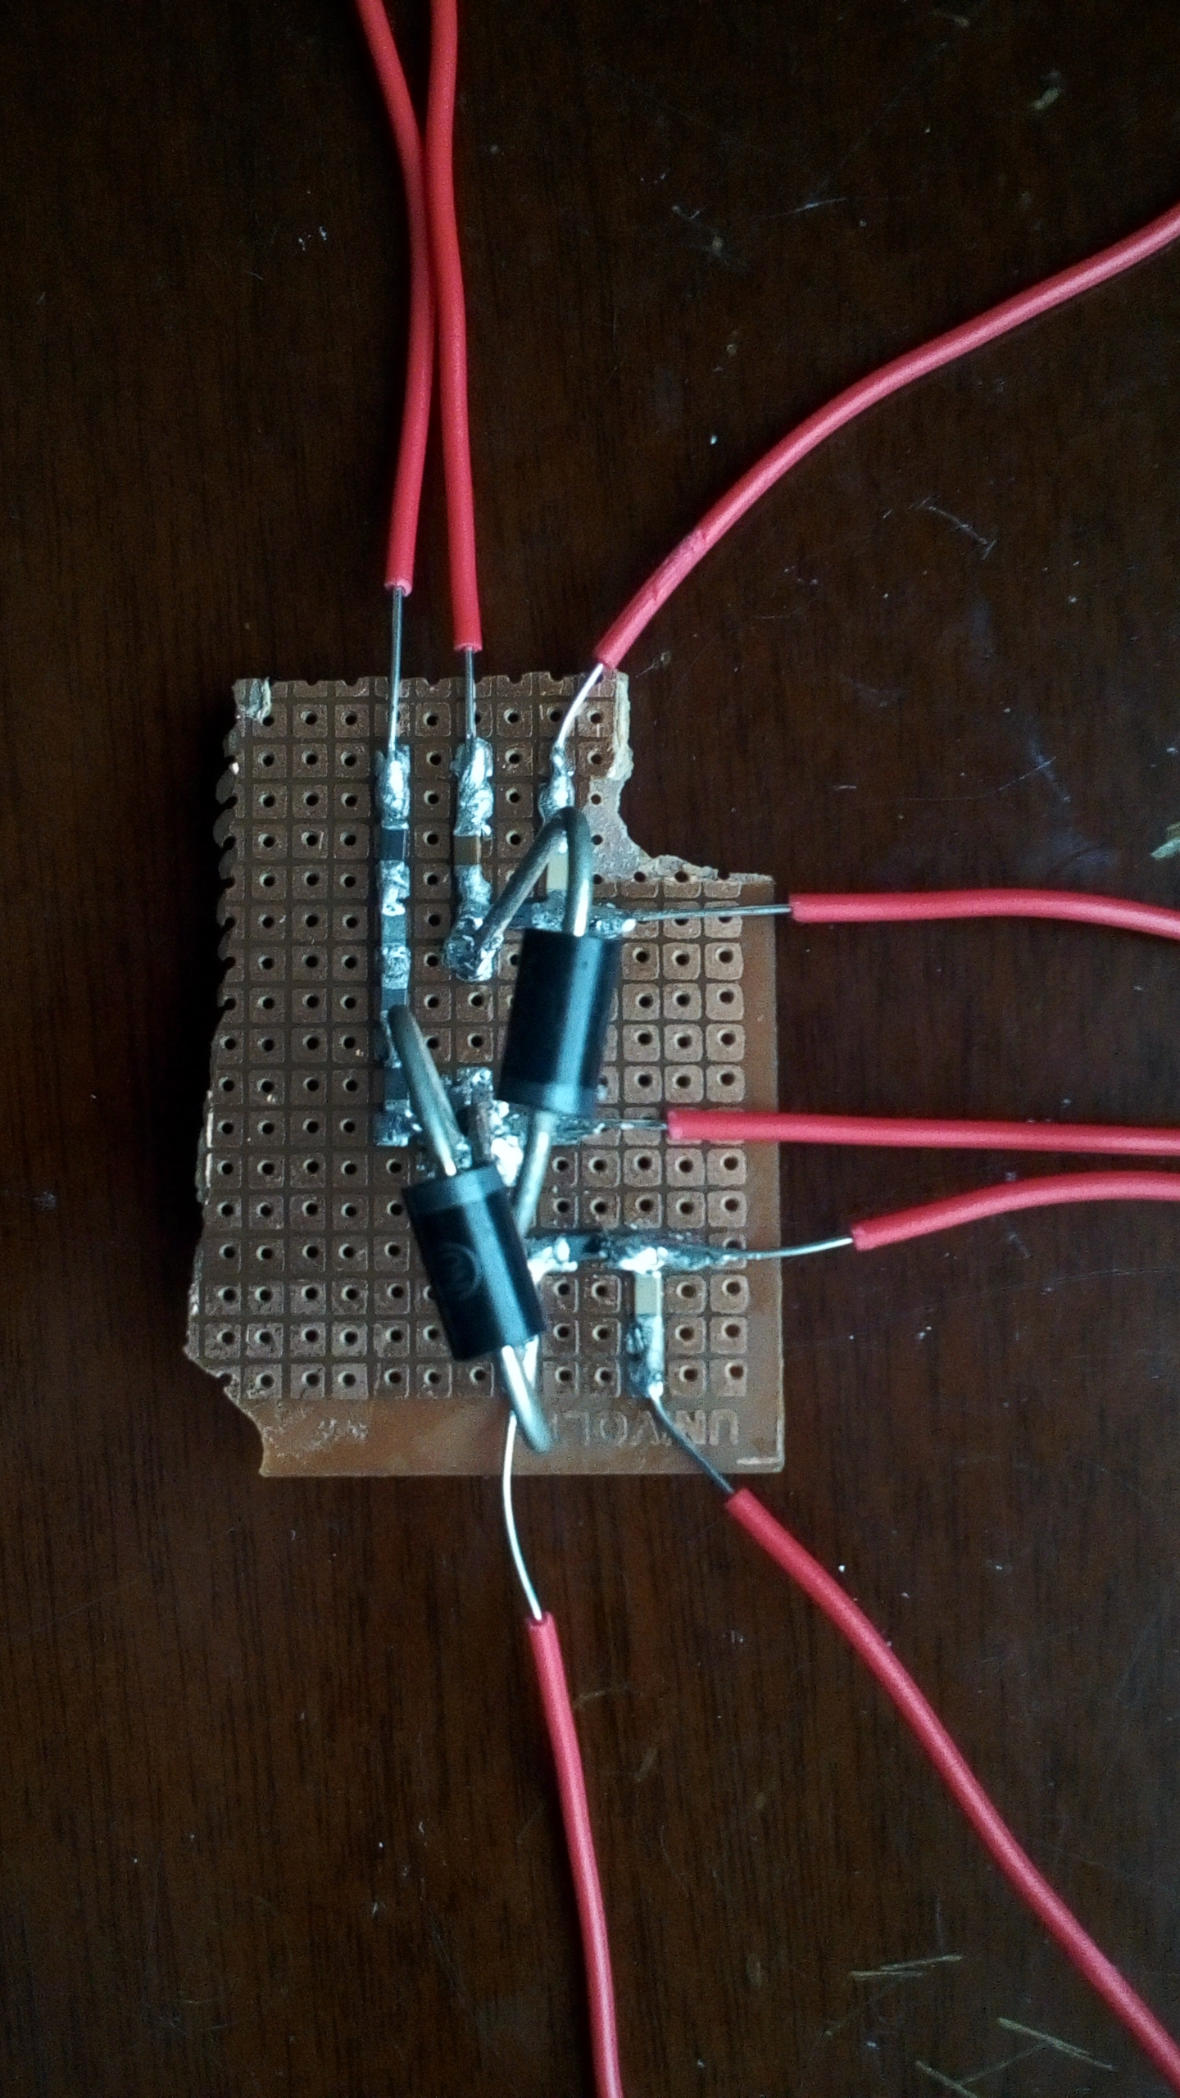
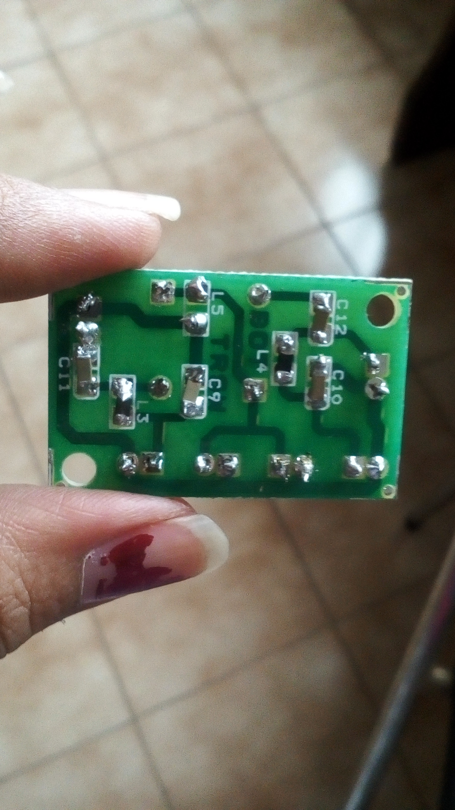
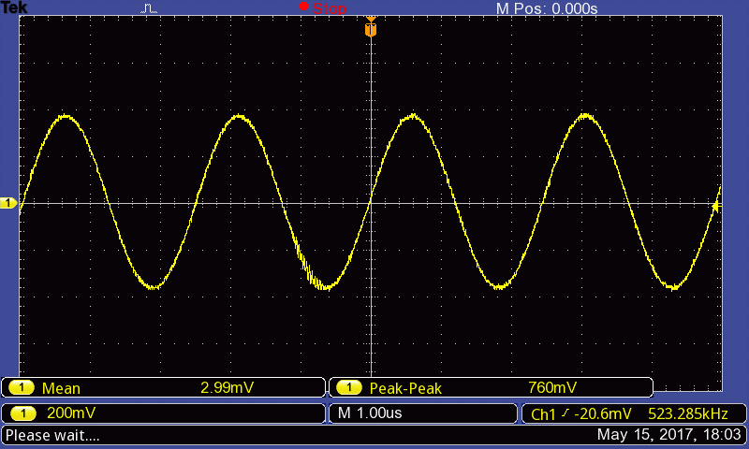
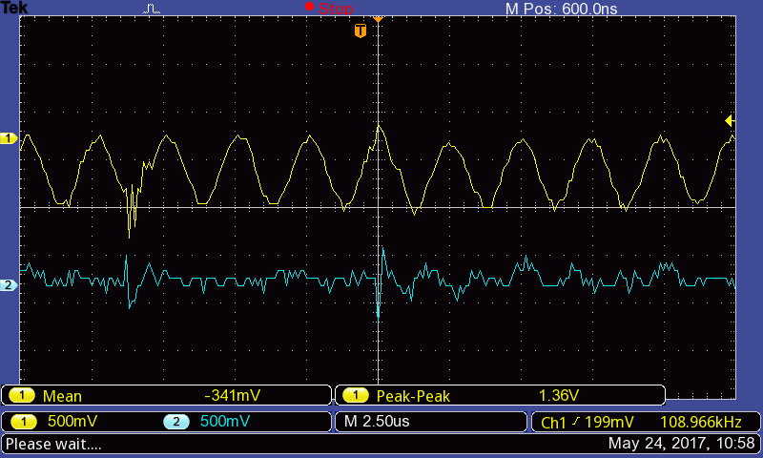
TR Switch bench test results
Isolation – 30dB
Input to the T-R switch
Output at transmit coil
Output at receive coil

Slide 10
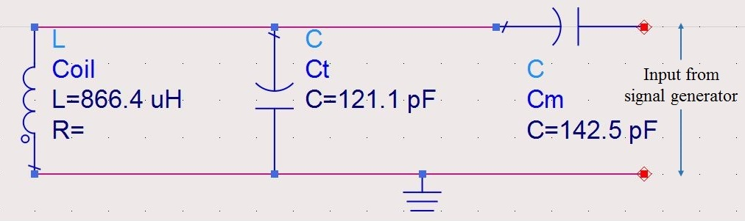
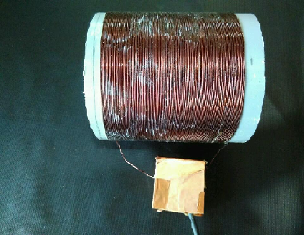
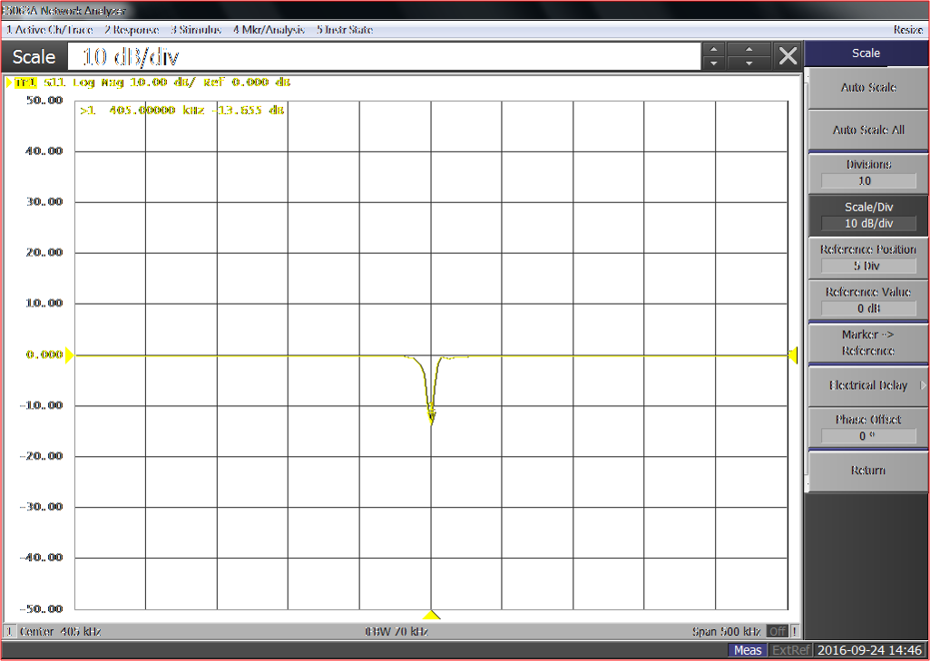
Transmit coil
Sl.No: | Parameters: | Values:
1. | Inductance | 866.4μH
2. | Tuning Capacitance | 121.1pF
3. | Matching Capacitance | 142.5pF
4. | Material | Copper
5. | Number of turns | 105
6. | Wire gauge | 18SWG (1.219mm)
7. | Diameter | 11cm
8. | Length | 10cm
9. | Type of coil | Volume coil
Resonating at 405 kHz , -13.6 dB
BW - 10.8kHz
Q – 37
Field produced: 5.7μT for 1 Amp / 1 Volt

Slide 11
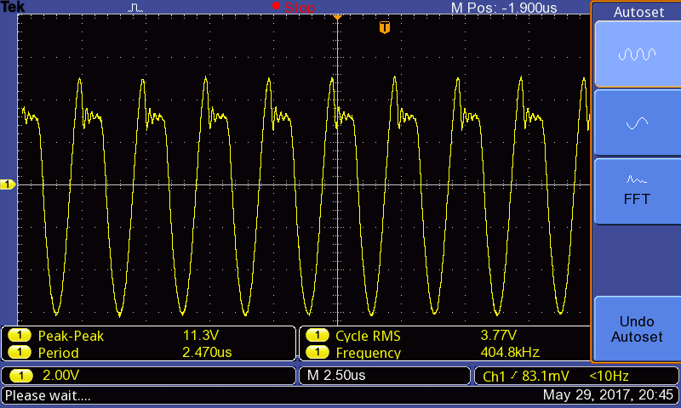
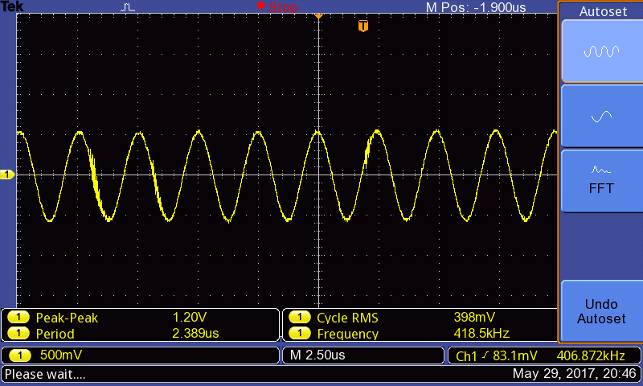
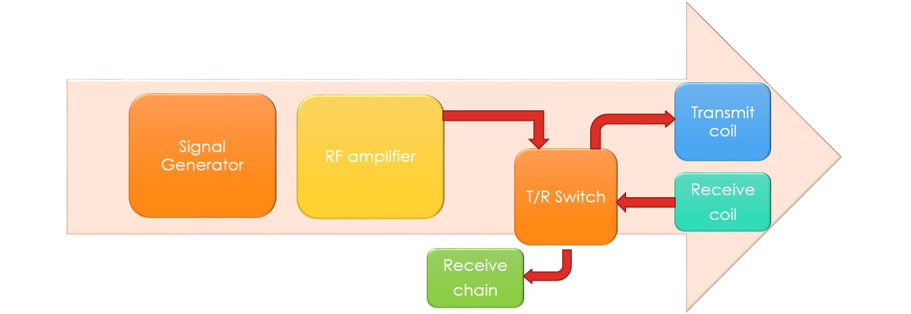
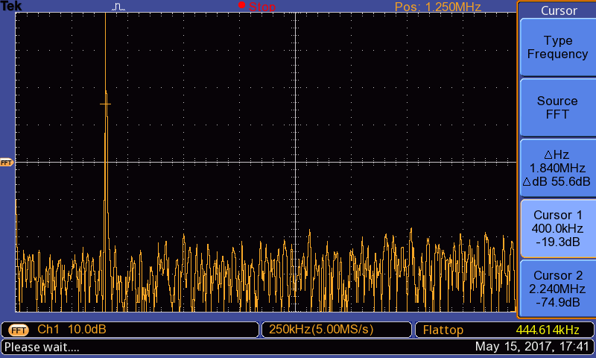
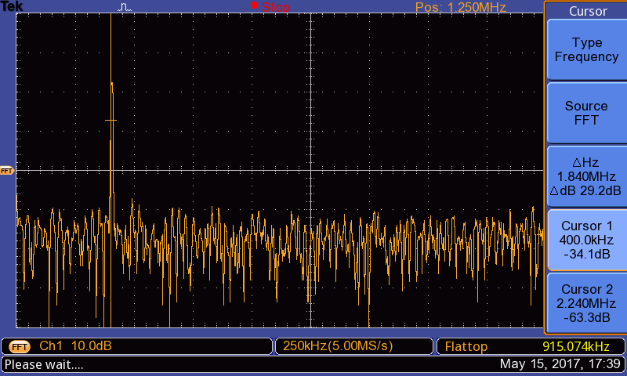
Tx – Rx TEST

Slide 12

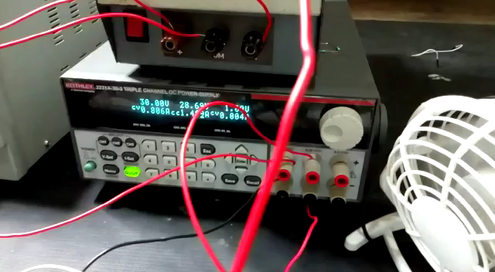
Tx – Rx TEST

Slide 13
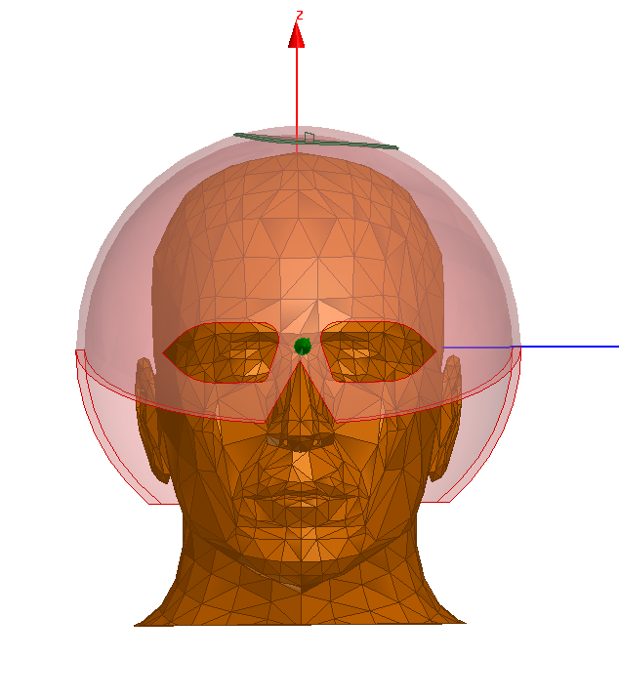
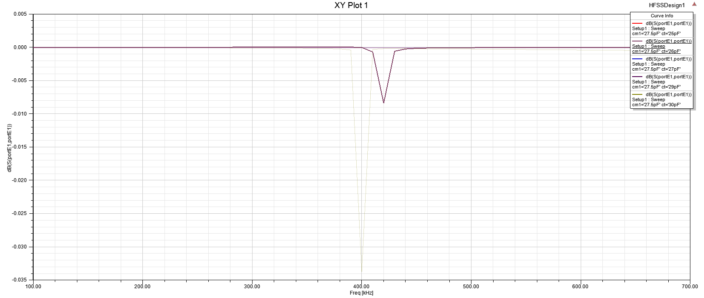
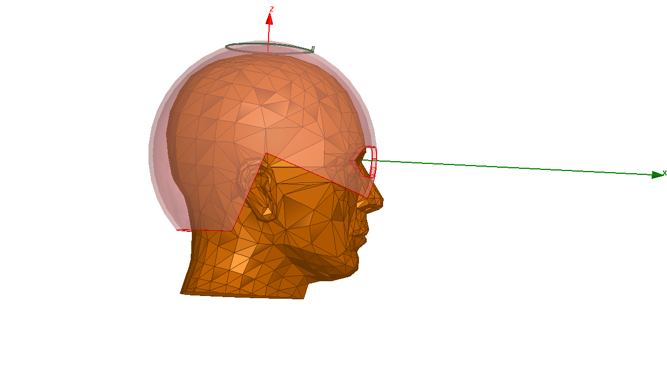
HFSS Simulation @ 405kHz
Helmet Design:
Diameter : 26 cm
Helmet Thickness: 5mm
Coil radius: 10cm
Inductance: 866 µH
Coil thickness : 1mm
Work in progress

Slide 14
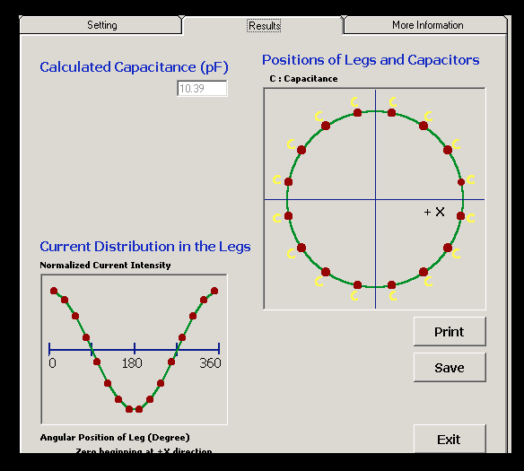
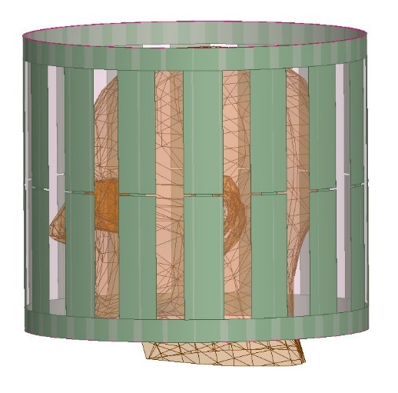
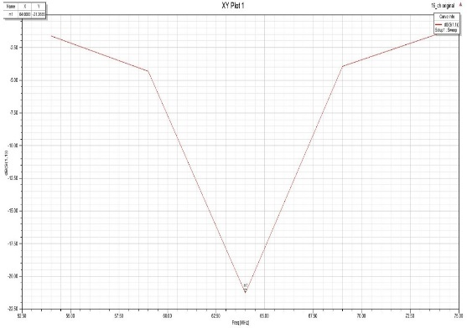
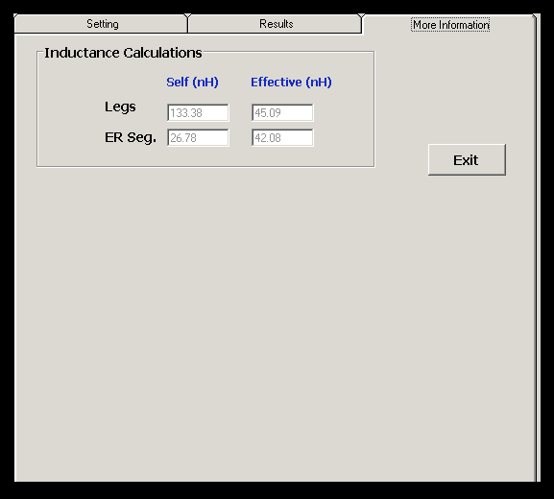
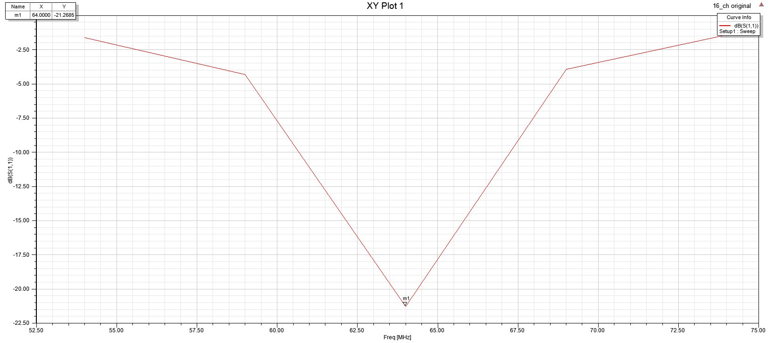
Design of birdcage Tx coil
Resonating frequency: 64 MHz
No. of rungs : 16
Coil radius: 15 cm
Leg length: 20 cm
Leg width : 2.5cm
ER seg length : 5.11 cm
ER seg width : 1.3 cm
Legs self : 130.9 nH
Legs Effective: 214.78 nH
ER seg self : 26.15 nH
ER Seg effective : 39.41 nH
 | Low pass | High pass
Capacitance | 10.39 pF | 137.54 pF
http://www.pennstatehershey.org/web/nmrlab/resources/software/javabirdcage

Slide 15
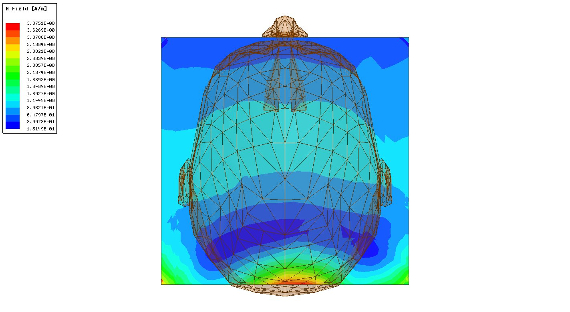
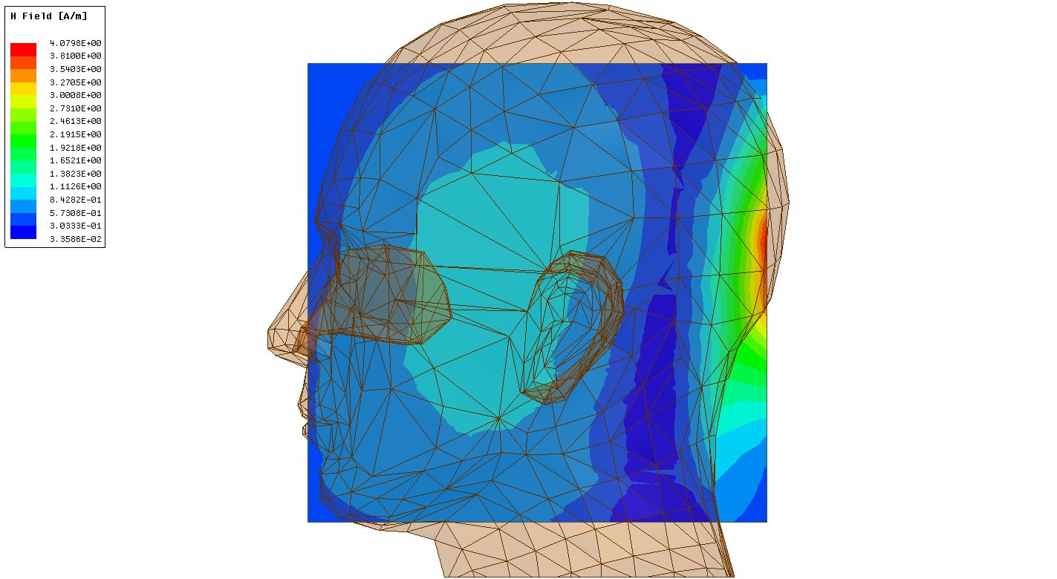

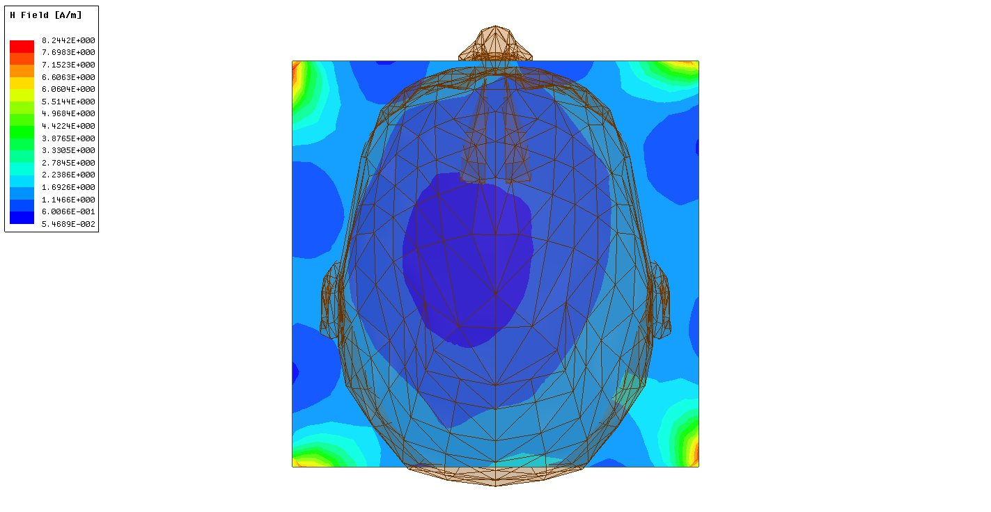
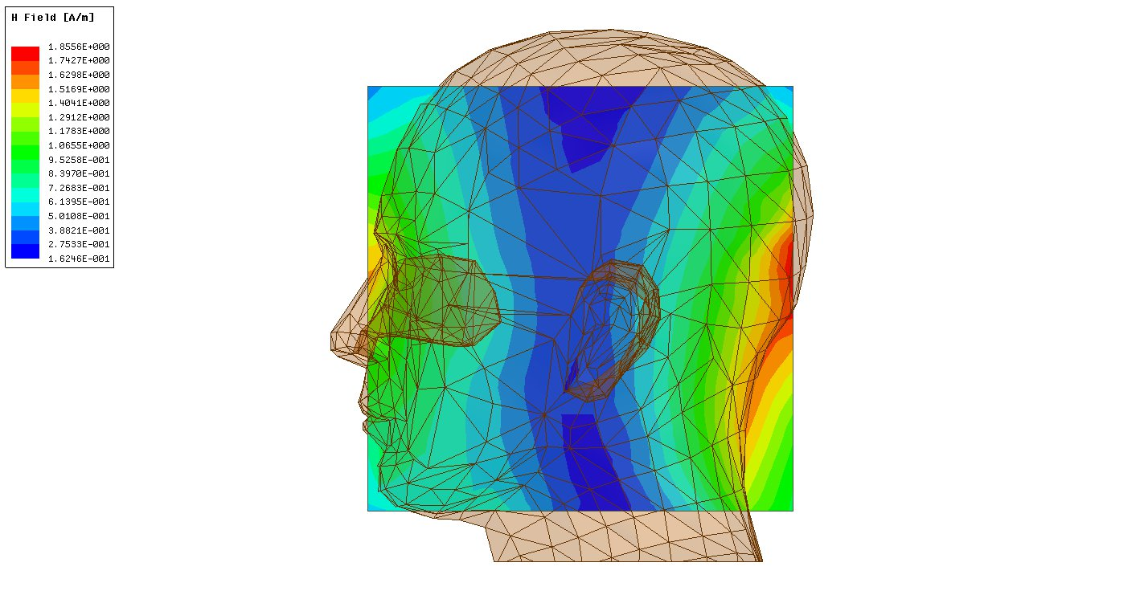
H FIELD SIMULATION FOR 1.5 T
Single
excitation
8 rung
excitation

Slide 16
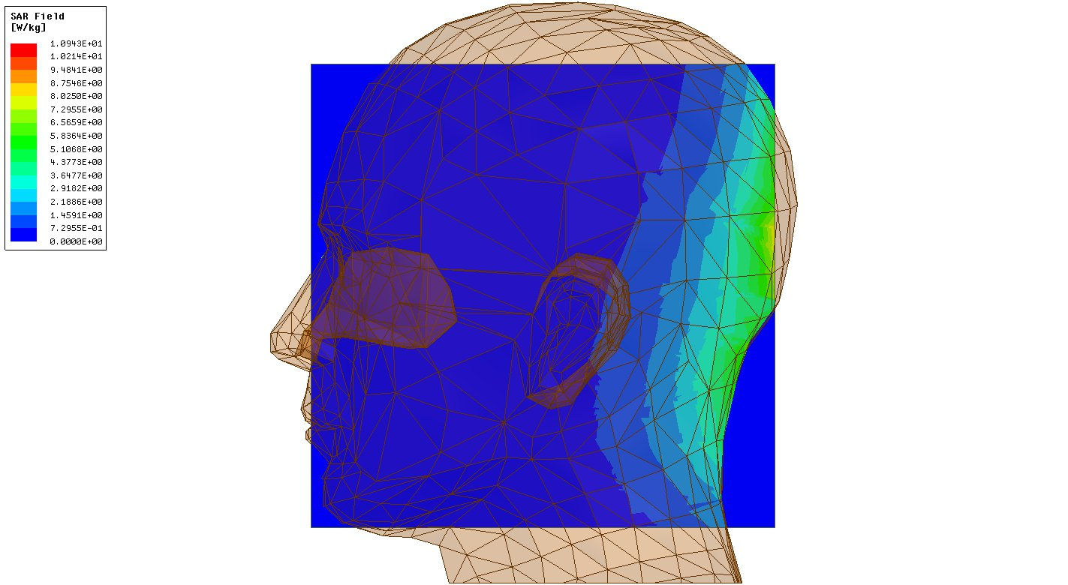
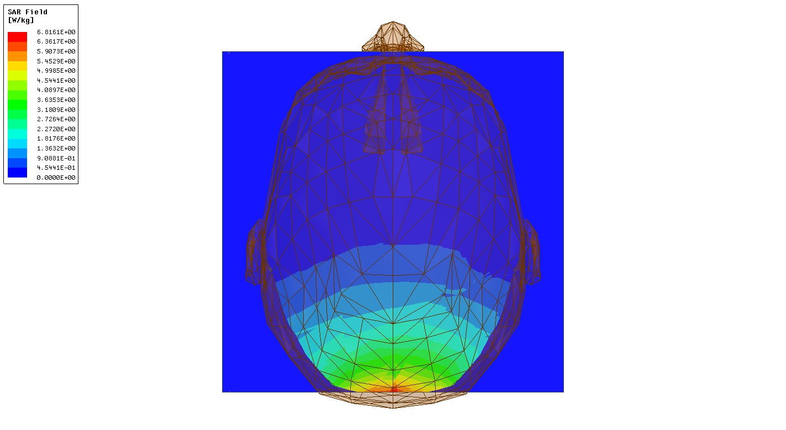
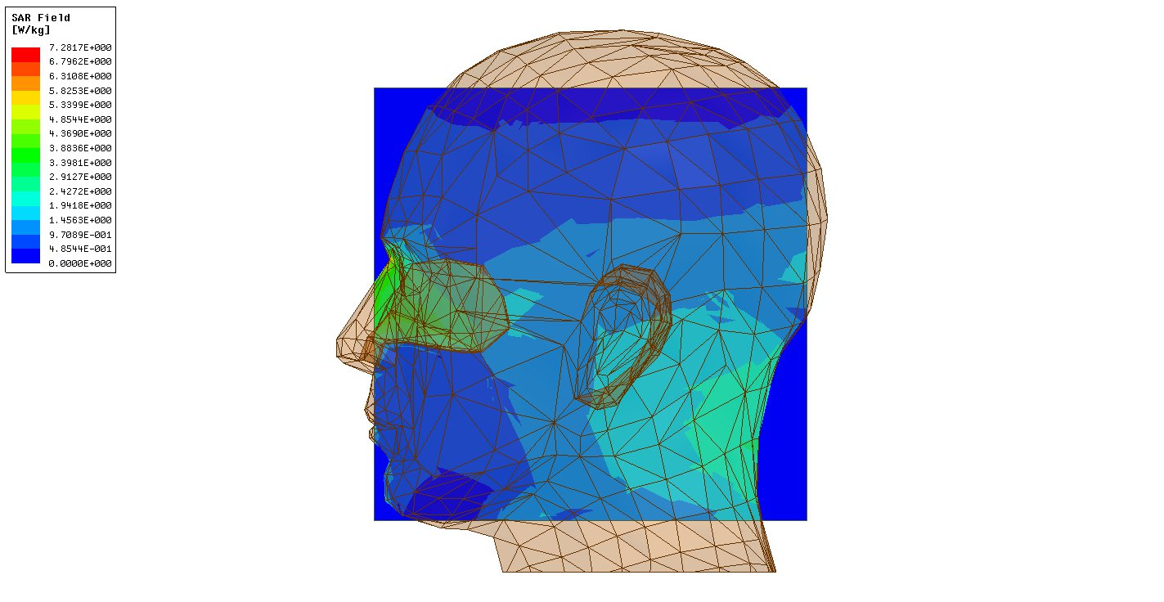
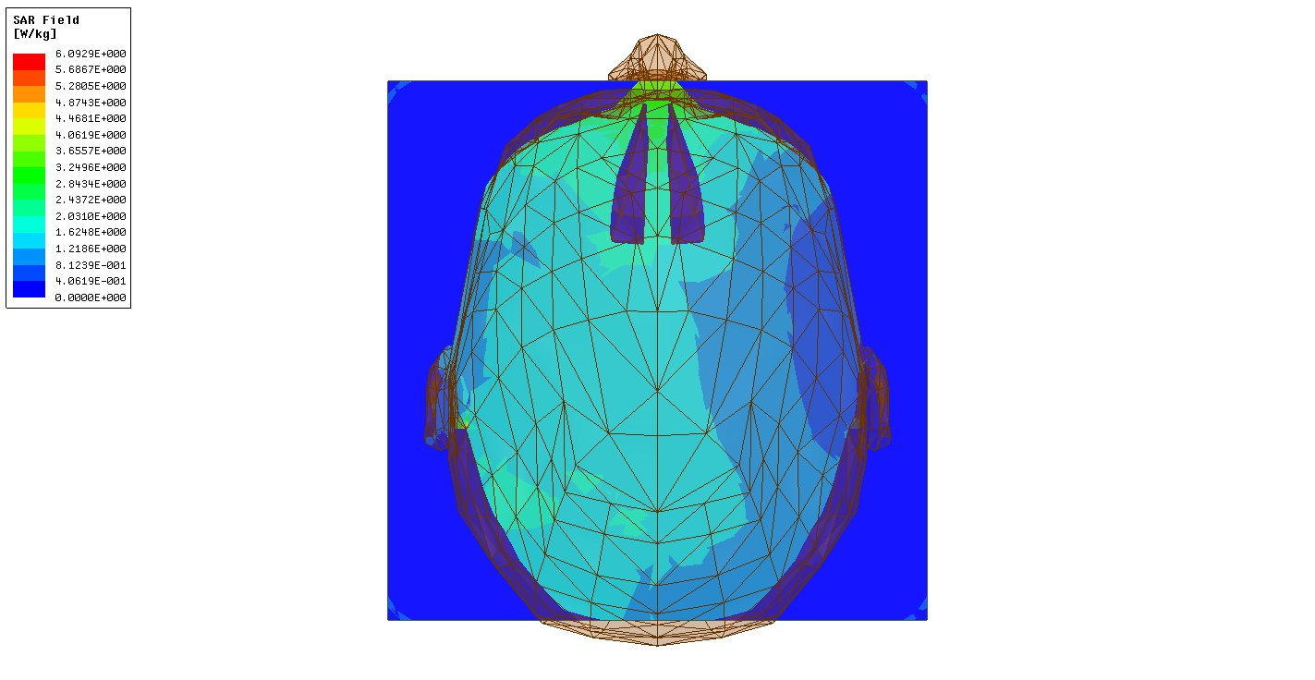
SAR field Simulation for 1.5 T
Single
excitation
8 rung
excitation

Slide 17
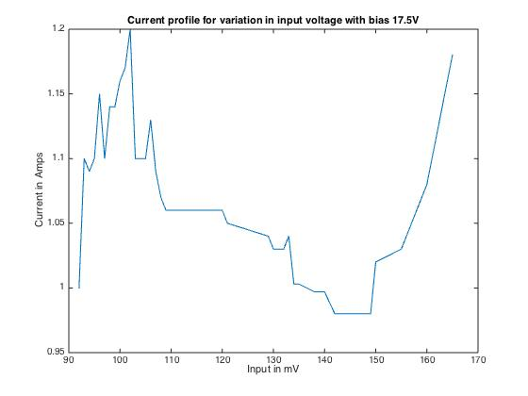
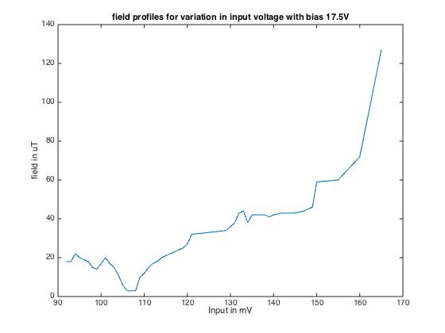
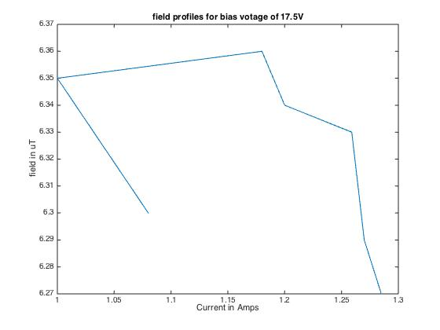
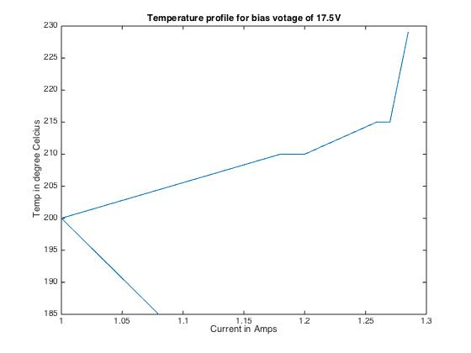
RF amplifier (9.5mT)
IRFZ44N GDS

Slide 18
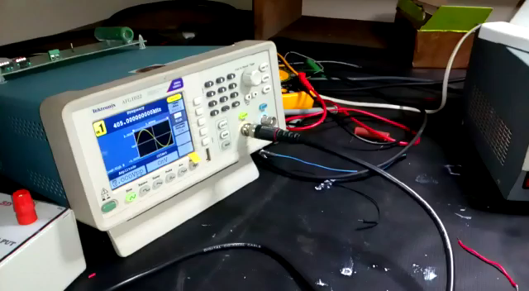
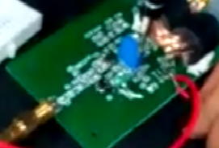
RF amplifier 9.5mT
IRFZ44N

Slide 19



TR Switch for 1.5T
TRANSMIT END
RECEIVE END
INPUT

Slide 20

TR Switch for 1.5 T
RECEIVE END
TRANSMIT END

Slide 21


TR Switch for 9.5mT

Slide 22

RF Amplifier for 1.5 T

Slide 23
Acknowledgements
Dr. Sairam Geethanath
Mr. Darshan
Mr. Thejas Vishnu
Mr. Syed Saad Siddiq

Slide 24
THANK you

